Slide 1
Agile Foundations with Scrum
Session 3: Scrum Roles Part 2

Slide 2
Manifesto for Agile Software Development
We are uncovering better ways of developing software by doing it and helping others do it.
Through this work we have come to value:
Individuals and interactions over processes and tools Working software over comprehensive documentation Customer collaboration over contract negotiation Responding to change over following a plan
That is, while there is value in the items on the right, we value the items on the left more.
Notes:
What is Agile is a question that gets asked a lot.
Agile is a buzz work that gets thrown around a lot.
At the core of all things agile is the Agile Manifesto.
If a practice, process, or tool can demonstrate that it holds true to all four of the agile values, we can confidently call it agile.

Slide 3
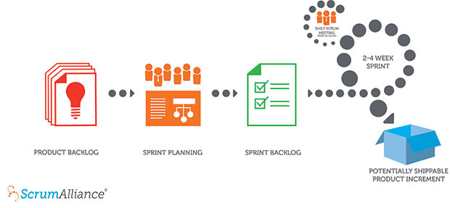
How Scrum Works
Notes:
A product owner creates a prioritized wish list called a product backlog.
During sprint planning, the team pulls a small chunk from the top of that wish list, a sprint backlog, and decides how to implement those pieces.
The team has a certain amount of time — a sprint (usually two to four weeks) — to complete its work, but it meets each day to assess its progress (daily Scrum).
Along the way, the ScrumMaster keeps the team focused on its goal.
At the end of the sprint, the work should be potentially shippable: ready to hand to a customer, put on a store shelf, or show to a stakeholder.
The sprint ends with a sprint review and retrospective.
As the next sprint begins, the team chooses another chunk of the product backlog and begins working again.

Slide 4
Roles Mapping: Group Activity
Review the analysis of the Role Mapping activity.

Slide 5
Scrum Terms
Time box – time window or time limit. Described in terms of duration. E.g: 2 hour time box.
Sprint – a time box during which the team will build, test, and deliver to the product owner a unit of work they have identified from the Product Backlog.
Release – a group of items from the product backlog that will be delivered to the end user together. A release can be built over multiple sprints.
User Story – a use case that describes product functionality from a user or actor perspective.
Product Backlog – a prioritized wish list of features, functionality, or use cases.
Sprint Backlog – the list of user stories and/or tasks that will be delivered by the development team by the end of the Sprint.
Sprint Goal – a simple statement of purpose for the team to achieve by the end of the Sprint.
Velocity – the average amount of work delivered in one Sprint by the team.
Story Point – a relative unit of measure for level of effort based on complexity.
Baseline Story – the story against which other stories are compared to determine their story point value.

Slide 6
RACI
Responsible – does the work.
Accountable – answerable for the work (only one person can be accountable).
Consulted – they contribute to the work.
Informed – they are updated on the work.

Slide 7
Product Ownership is a Big Job
Although the Product Owner can delegate just about all of the administration of the backlog to the Team, the Product Owner is accountable for the backlog.
A team member can administer the backlog and facilitate backlog grooming, but they cannot set priorities without the Product Owner’s approval.
User feedback and stakeholder relationship management can be delegated to the Dev Team, but the interpretation of that data, and any responses to findings, rest with the Product Owner.

Slide 8
Product Owners need Business Analysis
Develop User Stories and Backlog Items that the team can work from.
Collaborate with the Development Team on the Product Backlog in developing the technical specifications that describe the work the team will deliver.
Create business acceptance criteria for user stories.

Slide 9
Product Owners need Project Management
Planning releases (timing, dependency, process adherence, etc.)
Managing interdependencies (sometimes your product might require work to be delivered from another team).
Collaborate with the team to identify risks, understand the reality of feature implementation, and set priorities appropriately.
Communicate milestones to stakeholders.
Manage communications with users and stakeholders.
Plan production support.
Notes:
Transparency and honest are key to a successful team.
A team must be given time to go through the stages of team formation:
Forming – the team moves at a slow pace as they get to know each other. This stage often has confusion and uncertainty.
Storming – often has a good deal of conflict as folks hash out roles and accountability
Norming – the team begins to hit their stride, communicate well, and build trust. Conflicts are negotiated constructively.
Performing – the team has hit their stride and begin to deliver value, communicate efficiently, and collaborate as a habit.
Transforming/Adjourning – As an increment is closed, or a project comes to an end, the team composition may be adjusted. This will put the team back into the forming stage and the cycle begins again.

Slide 10
Scrum RACI
Break into groups of 3 – 5
Identify team roles for people in your group
Fill out the RACI, one per group
Remember, there can be only one A per row!

Slide 11
1:50 PM - Retrospective
4 Quadrants Exercise:
On a sticky note write (1 item per sticky):
What went well or not well; suggestions and shout-outs
Place on the appropriate quadrant.

